Slide 1
Analysis of skills affected due to Automation and AI
Instructor: Rong Liu
Course: BIA-660-C
Team Members: Group 5
Rohan Shah
Parth Parab
Purva Khopkar
Bhagyashree Shende

Slide 2
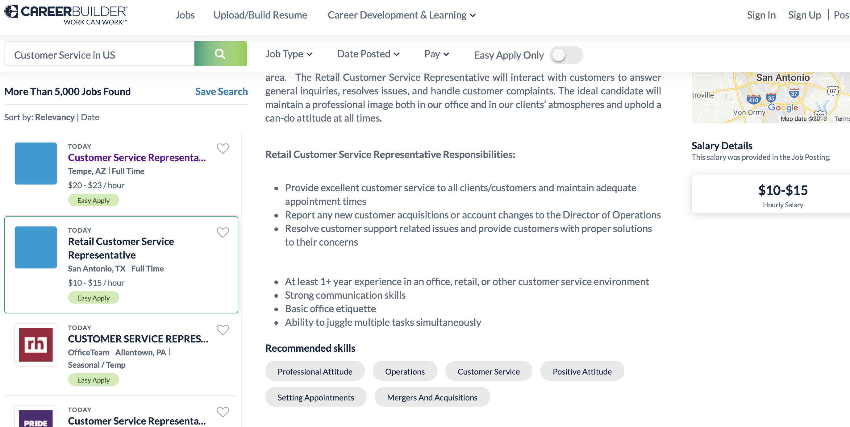
Introduction
Goal of the project: To cluster skills and activities from various job postings scraped
from “careerbuilder.com”
Cluster skills and activities from various job postings
Analyze the activities in the cluster to predict which clusters may be impacted due to Automation and AI

Slide 3
Project Workflow
Scrape required data
Extract activity phrases
Compare extracted activities with recommended skills
Use similarity check to prune unwanted activities
Perform clustering on the filtered activities
Cluster analysis and performance evaluation
Data cleaning and EDA

Slide 4

Web Scraping and Data Preprocessing

Slide 5
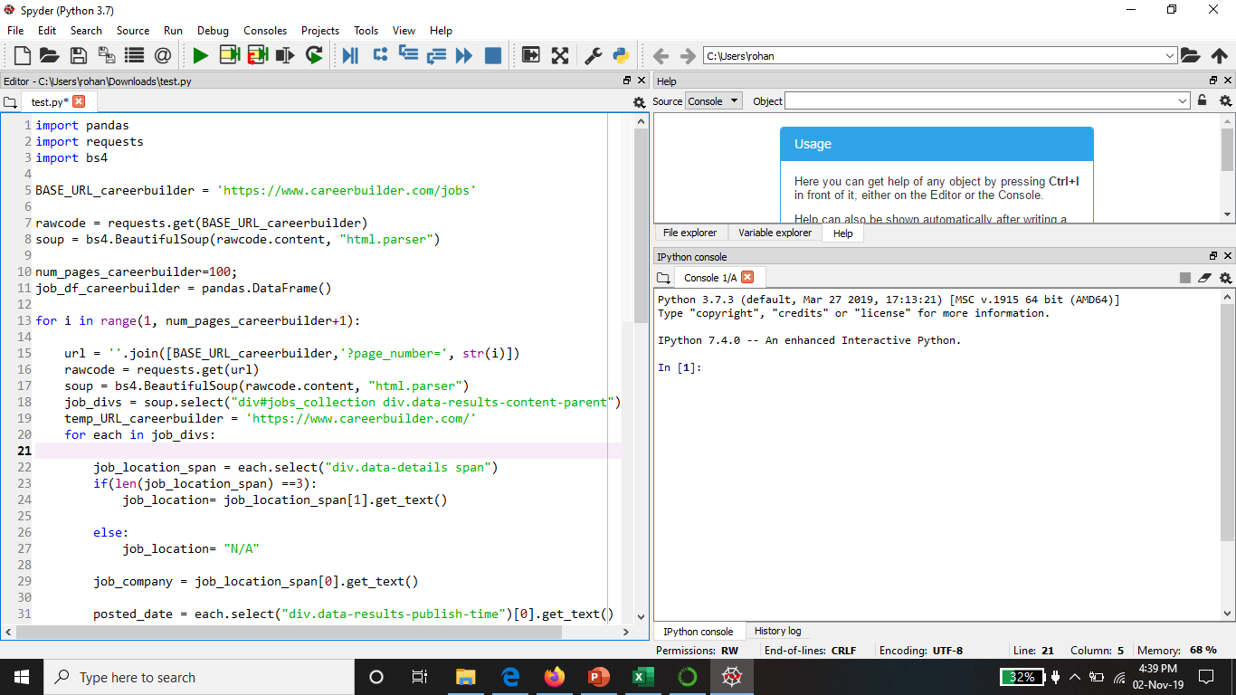
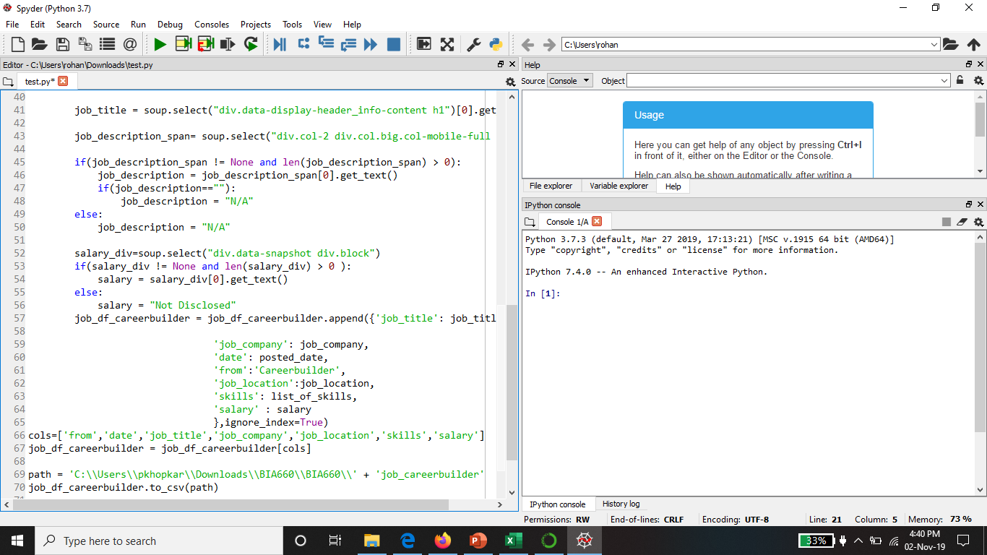
Web Scraping
Scrapped first 100 pages of Careerbuilder having 25 jobs each page to get details 10000 Jobs for 4 types of keywords namely Software Engineering, Manufacturing, Fabrication, Customer Service and store the data into file using BeautifulSoup

Slide 6
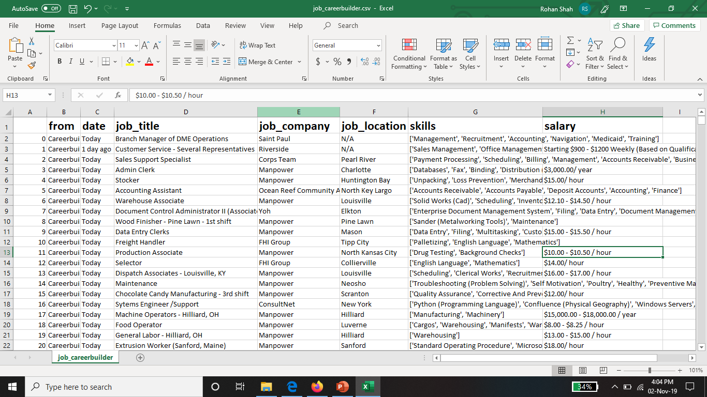
Scrapped data from Careerbuilder

Slide 7
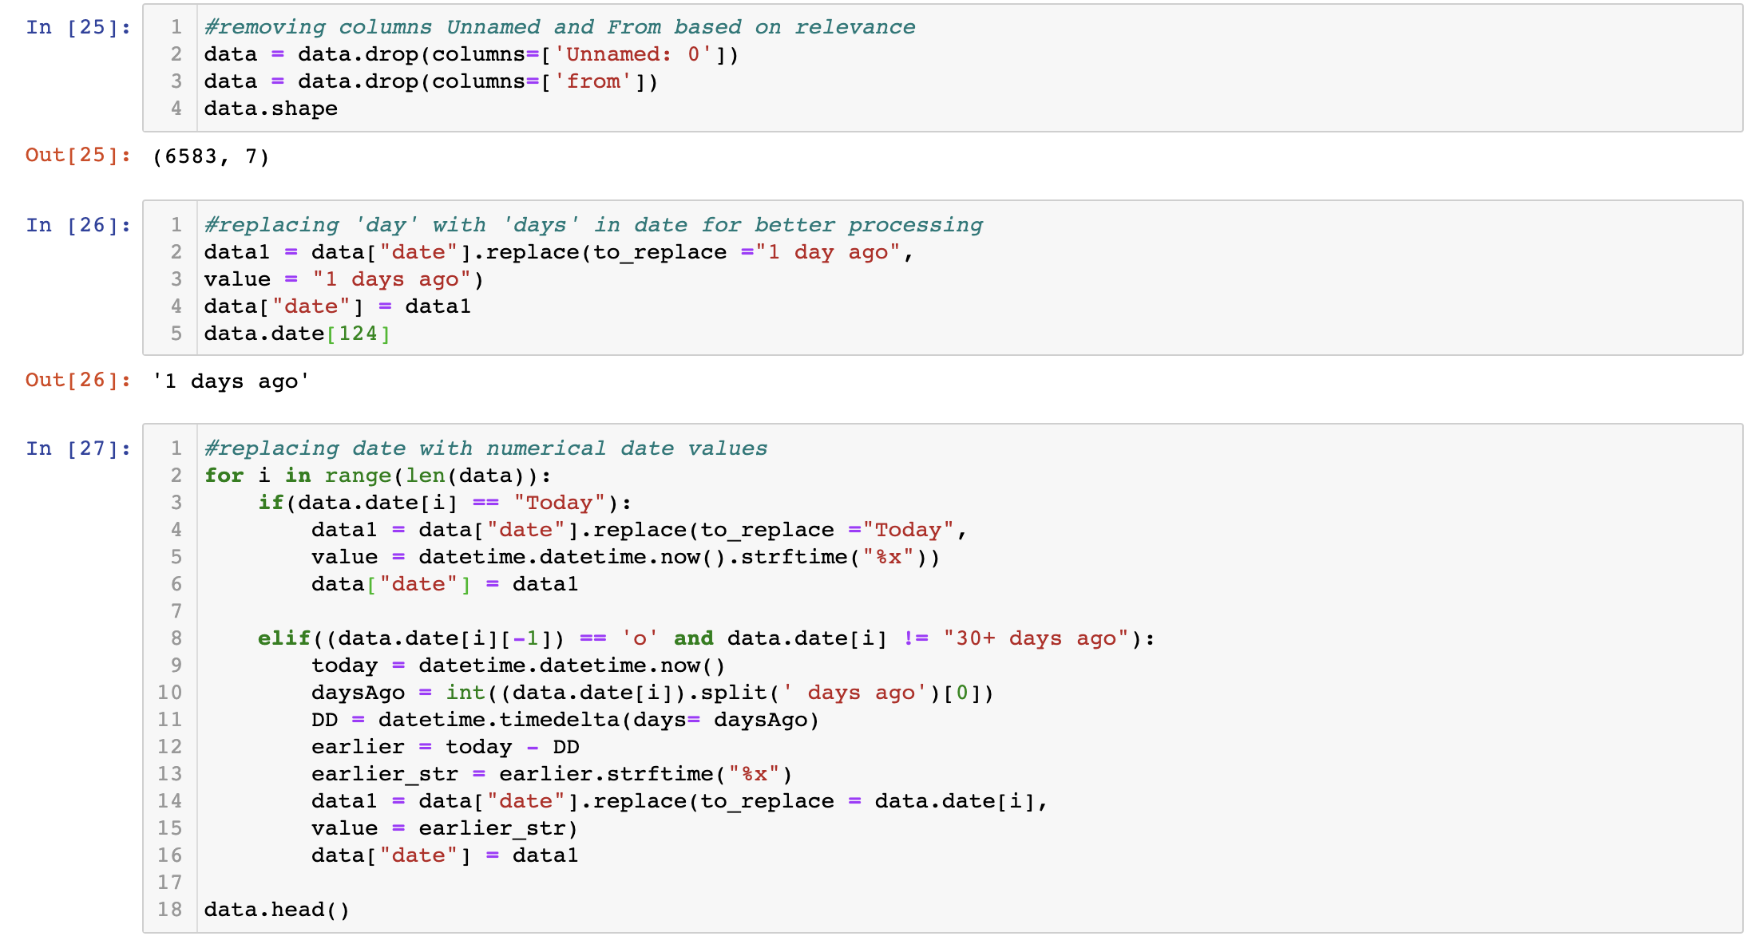
Data Pre-processing
Removing irrelevant columns and standardizing date format

Slide 8
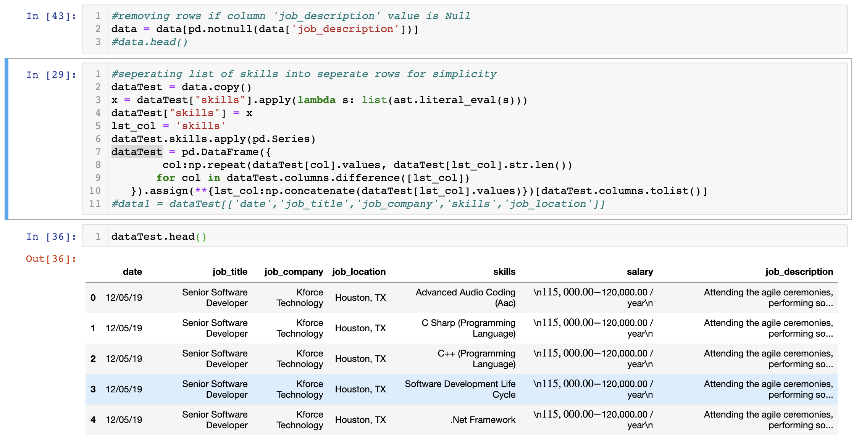
Data Pre-processing
Dropping rows with null values based on column ‘job_description’ and separating list of skills to separate rows

Slide 9
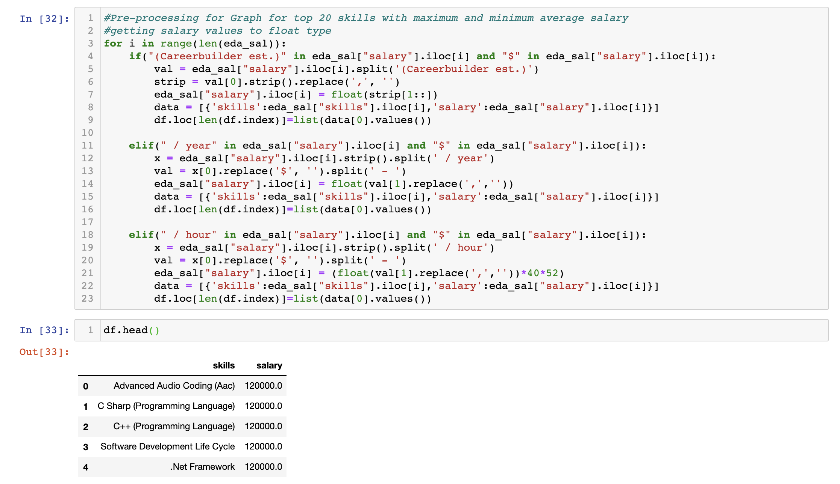
Data Pre-processing
Getting salary values to float type

Slide 10
Exploratory Data Analysis (EDA)

Slide 11
Exploratory Data Analysis (EDA)

Slide 12
Exploratory Data Analysis (EDA)
Dates from 9th Nov - 5th Dec

Slide 13
Exploratory Data Analysis (EDA)
count

Slide 14
Exploratory Data Analysis (EDA)

Slide 15
Exploratory Data Analysis (EDA)

Slide 16
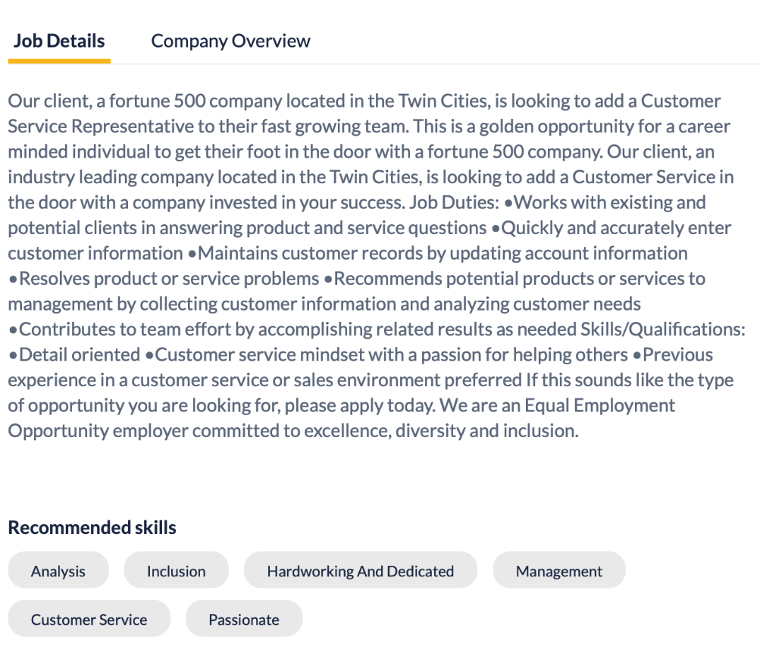
Extract Activity Phrases
Why extract activity phrases??
Recommended skills listed are abstract
Give no idea about the context
Example:
Recommended Skill is “Analysis”
Doesn’t give clear picture of what is actually expected

Slide 17
Extract Activity Phrases
Implementation Idea
Part of Speech Tagging
Chunking
Using Bag of words approach doesn’t capture structure of sentence
Chunking works on top of POS tagging, it uses pos-tags as input and provides chunks as output.
It is also important to understand context
Assigns part of speech to each word according to input sentence

Slide 18
Phrase Generator
Concept Used – Part of Speech Tagging
Part of Speech Tagging – Reads text and assign Part of Speech to each word
Examples of POS Tags – (NN, Noun) (VB, Verb) (JJ, Adjective) (RB, Adverb) etc.
Python library used: NLTK
Steps Involved:
Input : Job Description as text
Tokenize text using word_tokenize()
Remove stop words
apply pos_tag to above step that is nltk.pos_tag(tokenize_text)

Slide 19
Phrase Generator – Contd.
Concept Used - Chunking
Chunking - add more structure to the sentence by following parts of speech (POS) tagging
primary usage of chunking is to make a group of "noun phrases."
Rules for Chunking:
No pre-defined rules, we can combine them according to need and requirement.
Our rule – {<JJ.?>+<NN|NNS|NNP.?>+<NN|NNS|NNP.?>*}}
Examples of chunks returned:
[ ‘strong experience JAVA’, ‘verbal communication skills’, ‘punctual delivery’, ‘trade-off analysis’ , ‘operational support’ ]

Slide 20
Similarity Check
Concept Used –Word Vectors, Sum and Mean of Word Vectors
Train word2vec model for skill phrases obtained from Phrase Generator
Word2vec model builds vectors of individual words
Find mean vector for skill phrases
Use word vector of each word in skill phrase from the vocabulary
Add all word vectors
Divide it by the number of word in the phrase
Use the mean word vector to compare skill phrases to recommended skills
Examples of word vectors:
Construction Management [-2.53128121e-03 -1.77700538e-04 -2.65417900e-03 -3.87543434e-04 -1.15432322e-03 1.62815582e-03 1.00338110e-03 -1.52967067e-03................................-3.40627413e-03 -3.35135451e-03 -2.22289260e-03 3.08321090e-04 -3.39231896e-03 -2.66436837e-03 2.76020076e-03 4.11090790e-04 2.04549381e-03 9.39245452e-04 -1.60909526e-03 -1.57659827e-03 -1.14465761e-03 -3.12960986e-03 2.36541731e-03 -1.92798441e-03 -6.19727012e-04 -3.52221658e-03 -1.10748247e-03 -3.67690041e-03 3.10475053e-03 -1.39216939e-03]
internal company business systems [ 2.3599188e-03 -1.2206250e-03 7.9751259e-04 7.0600610e-05 -1.8862416e-03 -1.2368266e-04 -9.1530092e-06 8.7684812e- ....................................................................... 1.4695667e-03 -1.0500317e-03 -8.4408821e-04 -9.4342022e-04 5.0632062e-04 -3.1003775e-04 -1.4311107e-04 -4.1986880e-04 -1.4218048e-04 4.7879951e-04 -1.1398435e-03]

Slide 21
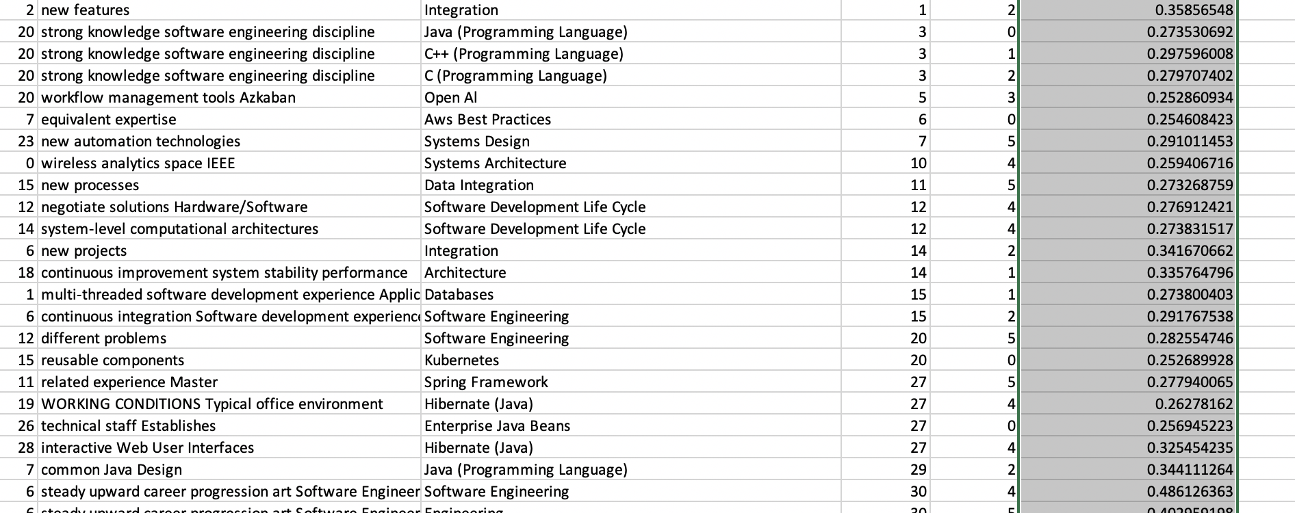
Similarity Check
Concept Used – Word Vectors, Sum and Mean of Word Vectors
Similarity Calculator:
Measure used -> Cosine Similarity
Python library used -> scipy import spatial
Finds the angle between the two vectors and calculates cosine value of that angle
Similarity score of 0.25 used as threshold
All the phrases greater than threshold value are selected

Slide 22
Word2Vec Model
Pretrained Model with GloVe - Global Vectors for Word Representation
GloVe is an unsupervised learning algorithm for obtaining vector representations for words
Gigaword 5th Edition corpora (6B tokens, 400K vocab) with 100 dimensions

Slide 23
Clustering
No labels for the matched activities- Unsupervised learning
Used two clustering methods
K means clustering – Centroid model
Hierarchical clustering – Connectivity model
Clustering performance evaluation (Based on cohesion and separation)
Silhouette Score (-1 to 1)
S is calculated as : 𝑠=𝑏−𝑎/max(𝑎,𝑏) where,
b - the mean distance between a sample and all other points in the next nearest cluster
a- the mean distance between a sample and all other points in the same cluster
Calinski-Harabaz Index (Higher the better)
S is calculated as : 𝑠=𝑏/𝑎 where
b - mean between cluster separation
a - mean within cluster separation

Slide 24
K-Means clustering
It is a partitioning algorithm - partitions dataset into as number of clusters to minimize intra-partition distances
Starts with a first group of randomly selected centroids, which are used as the beginning points for every cluster
Performs iterative (repetitive) calculations to optimize the positions of the centroids
Library – sklearn.cluster import Kmeans
Parameters:
K – Number of clusters ( 7-11)
Max_iterations ( 20 ,25)

Slide 25
Hierarchical Agglomerative Clustering
In this technique, each data point is considered as an individual cluster.
At each iteration, the similar clusters merge with other clusters until K clusters are formed.
Library - from sklearn.cluster import AgglomerativeClustering
Parameters:
Linkage = ward
Number of clusters k =range(7,11)

Slide 26
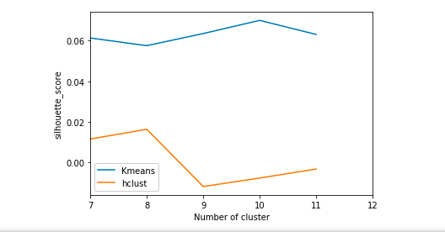
Performance Analysis of Clustering Algorithms
For clusters: 10
The average silhouette_score is : 0.06998661
The value of Calinski_value is : 233.82560805202831

Slide 27
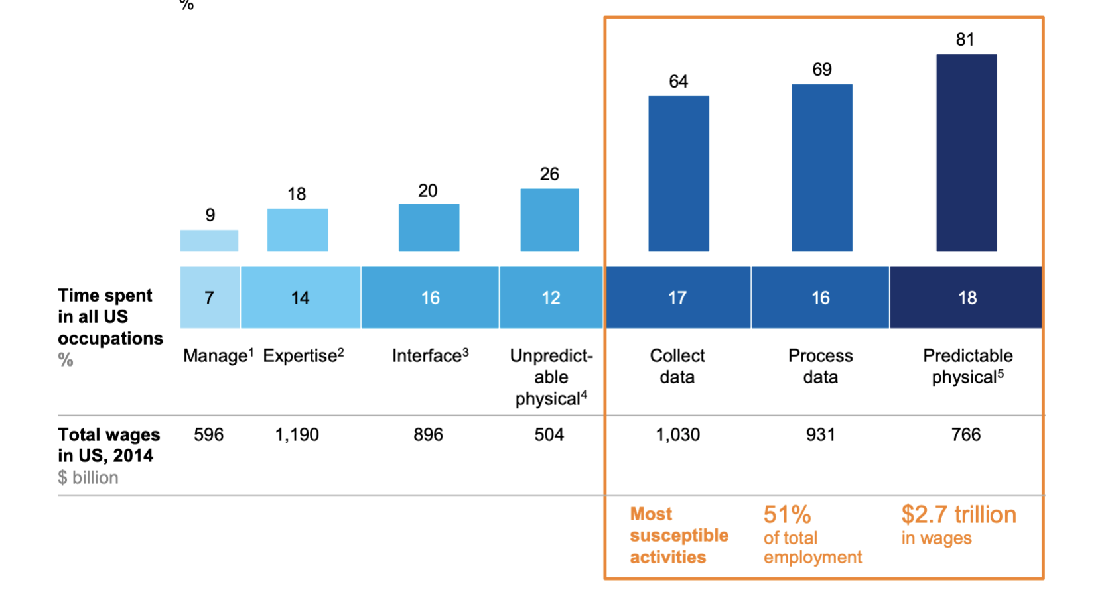
Dimensions of activities and impact of Automation
According to studies, all the activities in any occupation can be categorized into the following segments:
Managing and leading people
Expertise to decision making, planning and creative tasks
Interfacing with stakeholders
Collecting and Processing data
Physical work
Source: US Bureau of Labor Statistics ; McKinsey Global Institute Analysis
MOST IMPACTED BY AUTOMATION

Slide 28
Cluster Analysis
Physical work and Manual intervention
Cluster 0:
[ ‘able work’, ‘able lift’, ‘assigned work area’, ‘heavy work’, ’assist help callers’, ’regular basis help’, ’preferred ability lift’]
Cluster 1:
[‘on-site fabrication’, ‘hydraulic system’, ’disassemble mechanical equipment’, ’de-dusting equipment’]
Cluster 2:
[‘professional customer service’, Customer service experience Persuasive, ‘extraordinary customer service experience customers’]
Cluster 6:
[‘assist customer questions needs’,’ assist customer questions needs’,’ effective resolution issues’,’ protect quality condition items’]
Outlier Cluster:
[‘degree Information Systems’,’ degree Marketing’,’ degree Electrical Engineering’]
Expertise to decision making, planning and creative tasks
Cluster 3:
[ ‘service-oriented architecture’, ‘object oriented programming’, ‘third party auditors Judgment Decision Making’, ‘Complete video closeout audits’]
Cluster 4:
[‘critical thinking problem-solving skills’,’ deep consulting skills’,’ technical leadership’,’ Technical writing skills’]
Cluster 5:
[‘big data analysis application Data integration’,’ complex data models’,’ in-depth knowledge products services clients’]
Cluster 7:
[‘equivalent Docker Experience OpenShift Kubernetes’,’ Solid Experience Azure DevOps Able create Jenkins pipelines’,’ AWS Certified ’]
Cluster 8:
[‘implement optimize Data Engineering ETL’,’ stable Java applications’, ‘continuous integration server Fortran code’,’ popular Big Data frameworks Hadoop’]

Slide 29
Conclusion
Converting sentences to word vectors and using the word vectors for K-Means clustering gives the best results for this project
Value of k=10 is the most optimal value of k as the cohesion and separation scores are maximized at k=10

Slide 30
Future Work
Phrase chunking using more patterns to improve the overall performance
Check the clusters by using more clustering models(DBScan and BTM)
Compare the activities based on the historical data of job postings and compare which all activities are automated
Implementation of Doc2vec for activities and check cluster performance

Slide 31
THANK YOU!!
Questions???

